Slide 1
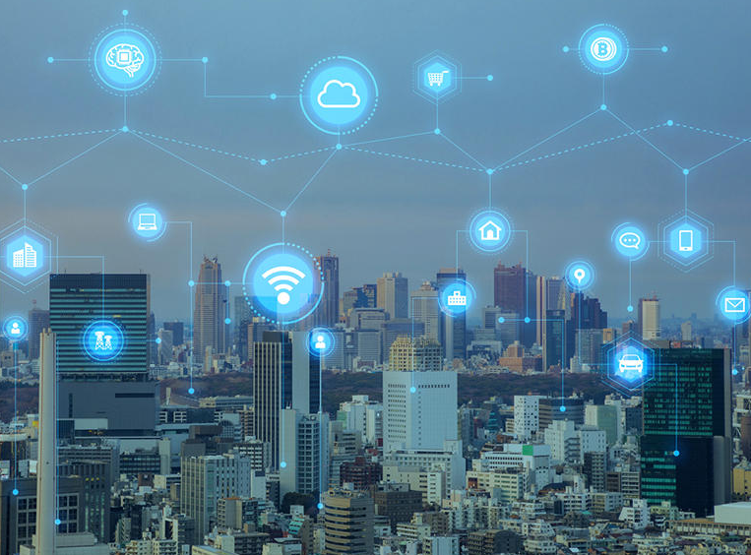
EDGE COMPUTING
PRESENTED BY :- SNEHAL TAWAR

Slide 2
Contents:
Cloud Computing
The Differences
MOST OF THE NEW OPPORTUNITIES FOR THE “CLOUD” LIE AT THE “EDGE”
Advantages
Applications
EDGE COMPUTING HAS PRIVACY BENEFITS, BUT THEY AREN’T GUARANTEED
References

Slide 3
Cloud Computing
Remote servers hosted on the internet store and process data, rather than local servers or personal computers.
Cloud computing is the on-demand availability of computer
system resources, especially data storage and
computing power, without direct active management by the user.

Slide 4
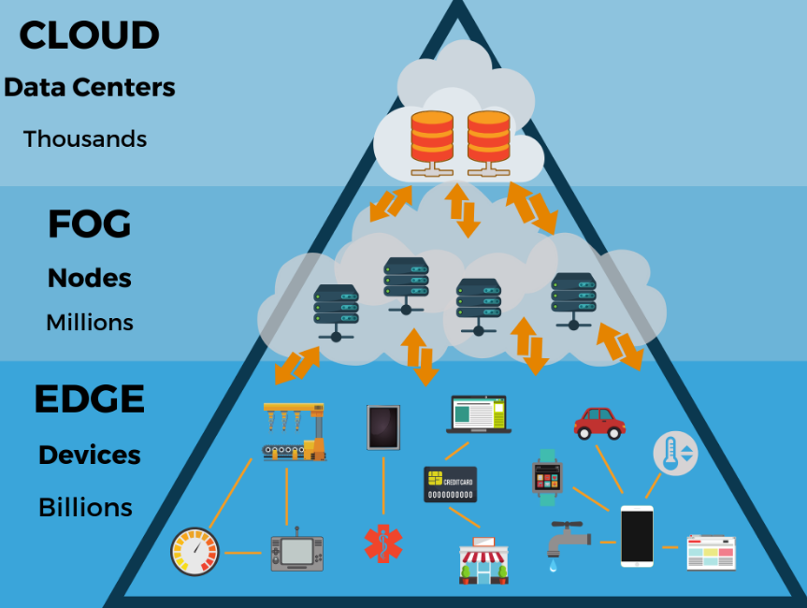
Differences

Slide 5
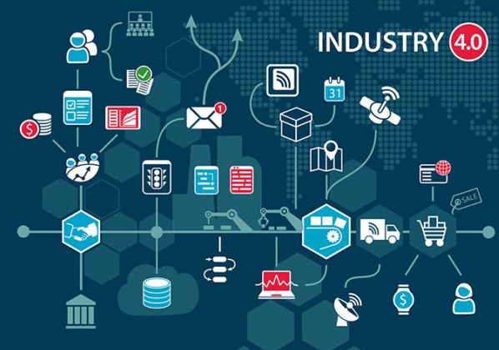
MOST OF THE NEW OPPORTUNITIES FOR THE “CLOUD” LIE AT THE “EDGE”
The word edge in this context means literal geographic distribution. Edge computing is computing that’s done at or near the source of the data, instead of relying on the cloud at one of a dozen data centers to do all the work. It doesn’t mean the cloud will disappear. It means the cloud is coming to you.
One great driver for edge computing is the speed of light. Example-Voice assistants typically need to resolve your requests in the cloud, and the roundtrip time can be very noticeable.

Slide 6
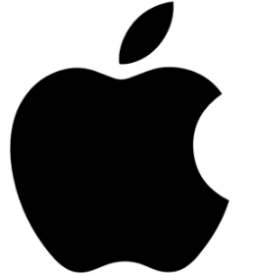
Advantages
For instance, if you buy one security camera, you can probably stream all of its footage to the cloud. If you buy a dozen security cameras, you have a bandwidth problem. But if the cameras are smart enough to only save the “important” footage and discard the rest, your internet pipes are saved.
Running AI on a user’s device instead of all in the cloud seems to be a huge focus for Apple and Google right now. It is –
Low Latency
Future Technology Enabled
Localized Solution
Data-Efficient
Real time Interactions
Heterogenous

Slide 7

Applications
Self-driving cars are, as far as I’m aware, the ultimate example of edge computing. Due to latency, privacy, and bandwidth, you can’t feed all the numerous sensors of a self-driving car up to the cloud and wait for a response. Your trip can’t survive that kind of latency, and even if it could, the cellular network is too inconsistent to rely on it for this kind of work.
Smart Surveillance System
Health Care
Financial Transactions
Self-Driving Cars
Industry 4.0

Slide 8

EDGE COMPUTING HAS PRIVACY BENEFITS, BUT THEY AREN’T GUARANTEED
It’s up to the big companies to decide how much control they want to gain over their users’ lives. But, it might also be up to us users to decide if there’s another way to build the future. Yes, it’s kind of a relief to take your hands off the steering wheel and let Larry Page guide you. But what if you don’t like where he’s going?
COMPANIES WILL CONTROL EVEN MORE OF YOUR LIFE EXPERIENCES THAN THEY DO RIGHT NOW

Slide 9
References
http://analytics-magazine.org/
https://www.thinkebiz.net/
https://www.forbes.com/
https://www.marketsandmarkets.com/
https://www.lifewire.com/
https://www.wikipedia.com/
https://www.youtube.com/

Slide 10

THANK YOU

